Slide 1
MP & Senator Briefing Independent Assessments Statement of Concern

Slide 2
Acknowledgements
Acknowledgment of Country
Acknowledgment of people with disability, families, advocates and self-advocates
Notes:
Acknowledgment of Country
I’d like to start by acknowledging the Wurundjeri people of the Kulin nation on whose land I am joining you from today, and the Traditional Custodians of the lands across Australia on which we are all meeting.
I recognise their continuing connection to land, water and community
I pay my respect to their Elders past, present and emerging, and any Aboriginal or Torres Strait Islander people in the briefing today.
Acknowledgment of advocates and self-advocates
I’d also like to acknowledge all the people with disability, their families and supporters who advocated for so long for the wonderful social change that is the National Disability Insurance Scheme.
As the CEO of Inclusion Australia, the national voice of people with intellectual disability and their families, I would also like to pay particular respect to self-advocates; the people with intellectual disability who have spoken out so strongly about their experiences and the changes, and respect, they deserve.
Accessibility
Today’s forum is as accessible as online forums can be. We have Auslan interpreters and live captioning – and I will work hard not to talk too fast.
Because of the requirement for people to be able to ‘pin’ the Auslan interpreter to their screen, it is not possible to share a PowerPoint or any other information via my screen.
All registered attendees should have received a copy of the Statement of Concern, which is now my job to brief you on.

Slide 3
Role today
Disabled Peoples Organisations
Disability Representative Organisations
Supporters & Allies
Notes:
Role today
I am honoured to be here today as a member and representative of the group of disability sector peaks – the Disabled Peoples and Disability Representative Organisations and their many disability sector supporters and allies who all want the NDIS to achieve what we wanted it to achieve when we all came together in 2011 to say that Every. Australian. Counts.
My role is to help explain to you why people with disability, their families and the organisations that represent them are all worried about changes the Australian Government wants to make to our NDIS.

Slide 4
Our NDIS
Guiding Principle #08 of the NDIS Act
“People with disabilities have the right to engage as equal partners in decisions that will affect their lives”
NDIS Corporate Plan
“Putting participants at the centre of everything we do”
Notes:
Our NDIS
We call it ‘our NDIS’ because in the two years between the beginning of the Every Australian Counts campaign and the launch of the NDIS trial sites, people with disability, families, service providers, and State and Territory governments, worked with the Commonwealth government to design the NDIS. Through genuine democratic consultations, the NDIS Act and NDIS Rules were codesigned with people with disability having real influence.
This co-design is reflected in the Guiding Principle #08 of the NDIS Act. It states, “people with disabilities have the right to engage as equal partners in decisions that will affect their lives”. The NDIS Corporate Plan reflects this through the commitment “putting participants at the centre of everything we do.”

Slide 5
Independent Assessments announced
“People with disability (will) have a seat at the table when it comes to implementing these reforms”.
Notes:
The independent assessments announcement
In August 2020, the Minister for the NDIS announced a ‘substantial package of reforms’ to the NDIS.
The announcement made clear the government was very concerned about the:
emerging evidence of lack of equity in access to the NDIS and size of support packages, and
increasing costs of the NDIS
The announcement said new independent assessments would be rolled out as the central source of ‘accurate’ information about a person with disability’s support needs. The announcement made clear that these assessments were intended to be the determining factor on a person’s eligibility for the NDIS, and on the support package they would receive.
The Minister also stated that he would “ensure people with disability have a seat at the table when it comes to implementing these reforms”.

Slide 6
The immediate problems
People with disability were not consulted prior to the decision
This is a fundamental change to the way the NDIS works
The tools were designed for a different purpose
No transparent and thorough evaluation
Notes:
Three immediate problems
However, as the community outcry over the following weekend (and ever since) showed, there were three big problems with that announcement:
The government had NOT consulted with people with disability about these concerns, what the underlying reasons might be, or about solutions to these challenges. In contrast with the extensive consultations in progress in the Aged Care sector, it had decided on its own solution.
The government had decided to use tools – assessments of a person’s function – to determine the funding that person would receive for their support needs. As many experts have since explained, these tools were not designed for this purpose.
The government had already made the decision to use these tools without comprehensive testing on whether in fact they were ‘accurate’ and or worked for this new purpose. The pilot used as evidence was very small and was not independently evaluated. This means the NDIS changed the use of the tools, as well as inventing its own new funding algorithm, without community transparency and oversight.
The fundamental issue
The immediate outcry occurred because the government broke its fundamental promise to people with disability to engage as equal partners in decisions that will affect their lives. The mantra ‘Nothing about us, without us’ is not a negotiable or a privilege. The NDIS Act - the law - acknowledges this as a right.
Therefore, the first and primary request to government is to STOP the rollout of compulsory assessments as they are currently planned, and to co-design a new access and planning process with people with disability, their families, supporters and the organisations who represent them.
What if the information is not ‘accurate’?
The announcement about independent assessments said they would be the central source of ‘accurate’ information about a person with disability’s support needs. But we do not have any evidence that they are accurate.
In fact, many experts and academics have said that the tools used in the assessments were not designed to determine the level of support funding needed by an individual.
The government has not told us how assessment results will be used to work out a person’s budget. We have not been told how the level of funding in a package might change.
The government has also said the results of the assessment cannot be challenged or appealed. Even though it hasn’t proved that the results will be accurate.
We don’t think that is a good way to make big changes. In fact, we think it is dangerous to make major changes to the lives of nearly half a million Australians, about 60% of whom have a cognitive disability, without rigorously testing the impact using the best evidence available.
We think it is unfair that people might miss out on the NDIS, or not have their support needs met.
We think there needs to be a strong transparent and independent evaluation of proposed tools and methods to show they are accurate.
Further problems
As more information has come out about how the independent assessments will be conducted and used, our worries have increased:
We’re worried that because assessors won’t know a person, or spend very long with them, they may not take into account people’s complicated lives and situations. They may even be judgemental about them.
Many people with disability have experienced violence, abuse, neglect and exploitation. We needed to have a Royal Commission because of this. Therefore, we’re worried working with someone they don’t know might be difficult or damaging for some people with disability.
We are also worried about people who don’t have anyone else in their lives who can give accurate, reliable or independent back-up information.
Many people with disability need assessors with specialised experience and skills. We are worried the assessors won’t have the right experience, skills or training for people with “invisible” or complex disabilities, or LGBTIQA+ people.
We are worried about the cultural safety of First Nations people and people from culturally or linguistically diverse (CALD) backgrounds.
There are some challenges. Change is OK.
I want to be clear that our worries don’t mean we are against change. Because the NDIS is world leading, it does need to try new things.
And it is true that, right now, the NDIS is complex and difficult to navigate. There are problems with fairness and consistency. While the scheme works well for some, others miss out.
We want the NDIS to be fair and consistent. Of course. But we are concerned these changes will make things worse not better. We are concerned that the new process for assessment and planning won’t consider the individual needs and circumstances of people with disability.
The obvious solution
There is an obvious solution.
The Australian Government and people with disability, families and service providers could look at the problems and come up with solutions that we think will work together. Just like we did to make the NDIS happen.
These solutions could include trials of a range of ways to improve access and planning consistency, and should be evaluated so that evidence based changes are made.
We want to help
We want to make sure the NDIS is the world-leading scheme we believe it can and should be. After all it’s our NDIS. It belongs to our community.
The NDIS is a new system. It was deliberately designed to be different to the old systems, which left people with disability ‘Shut Out’. A critical difference is the NDIS is individualised and personalised. Every NDIS participant should get a plan that supports their unique needs and circumstances.
We do not want the NDIS we fought for to be turned into Workcover or Centrelink.
We want the NDIS we fought for.

Slide 7
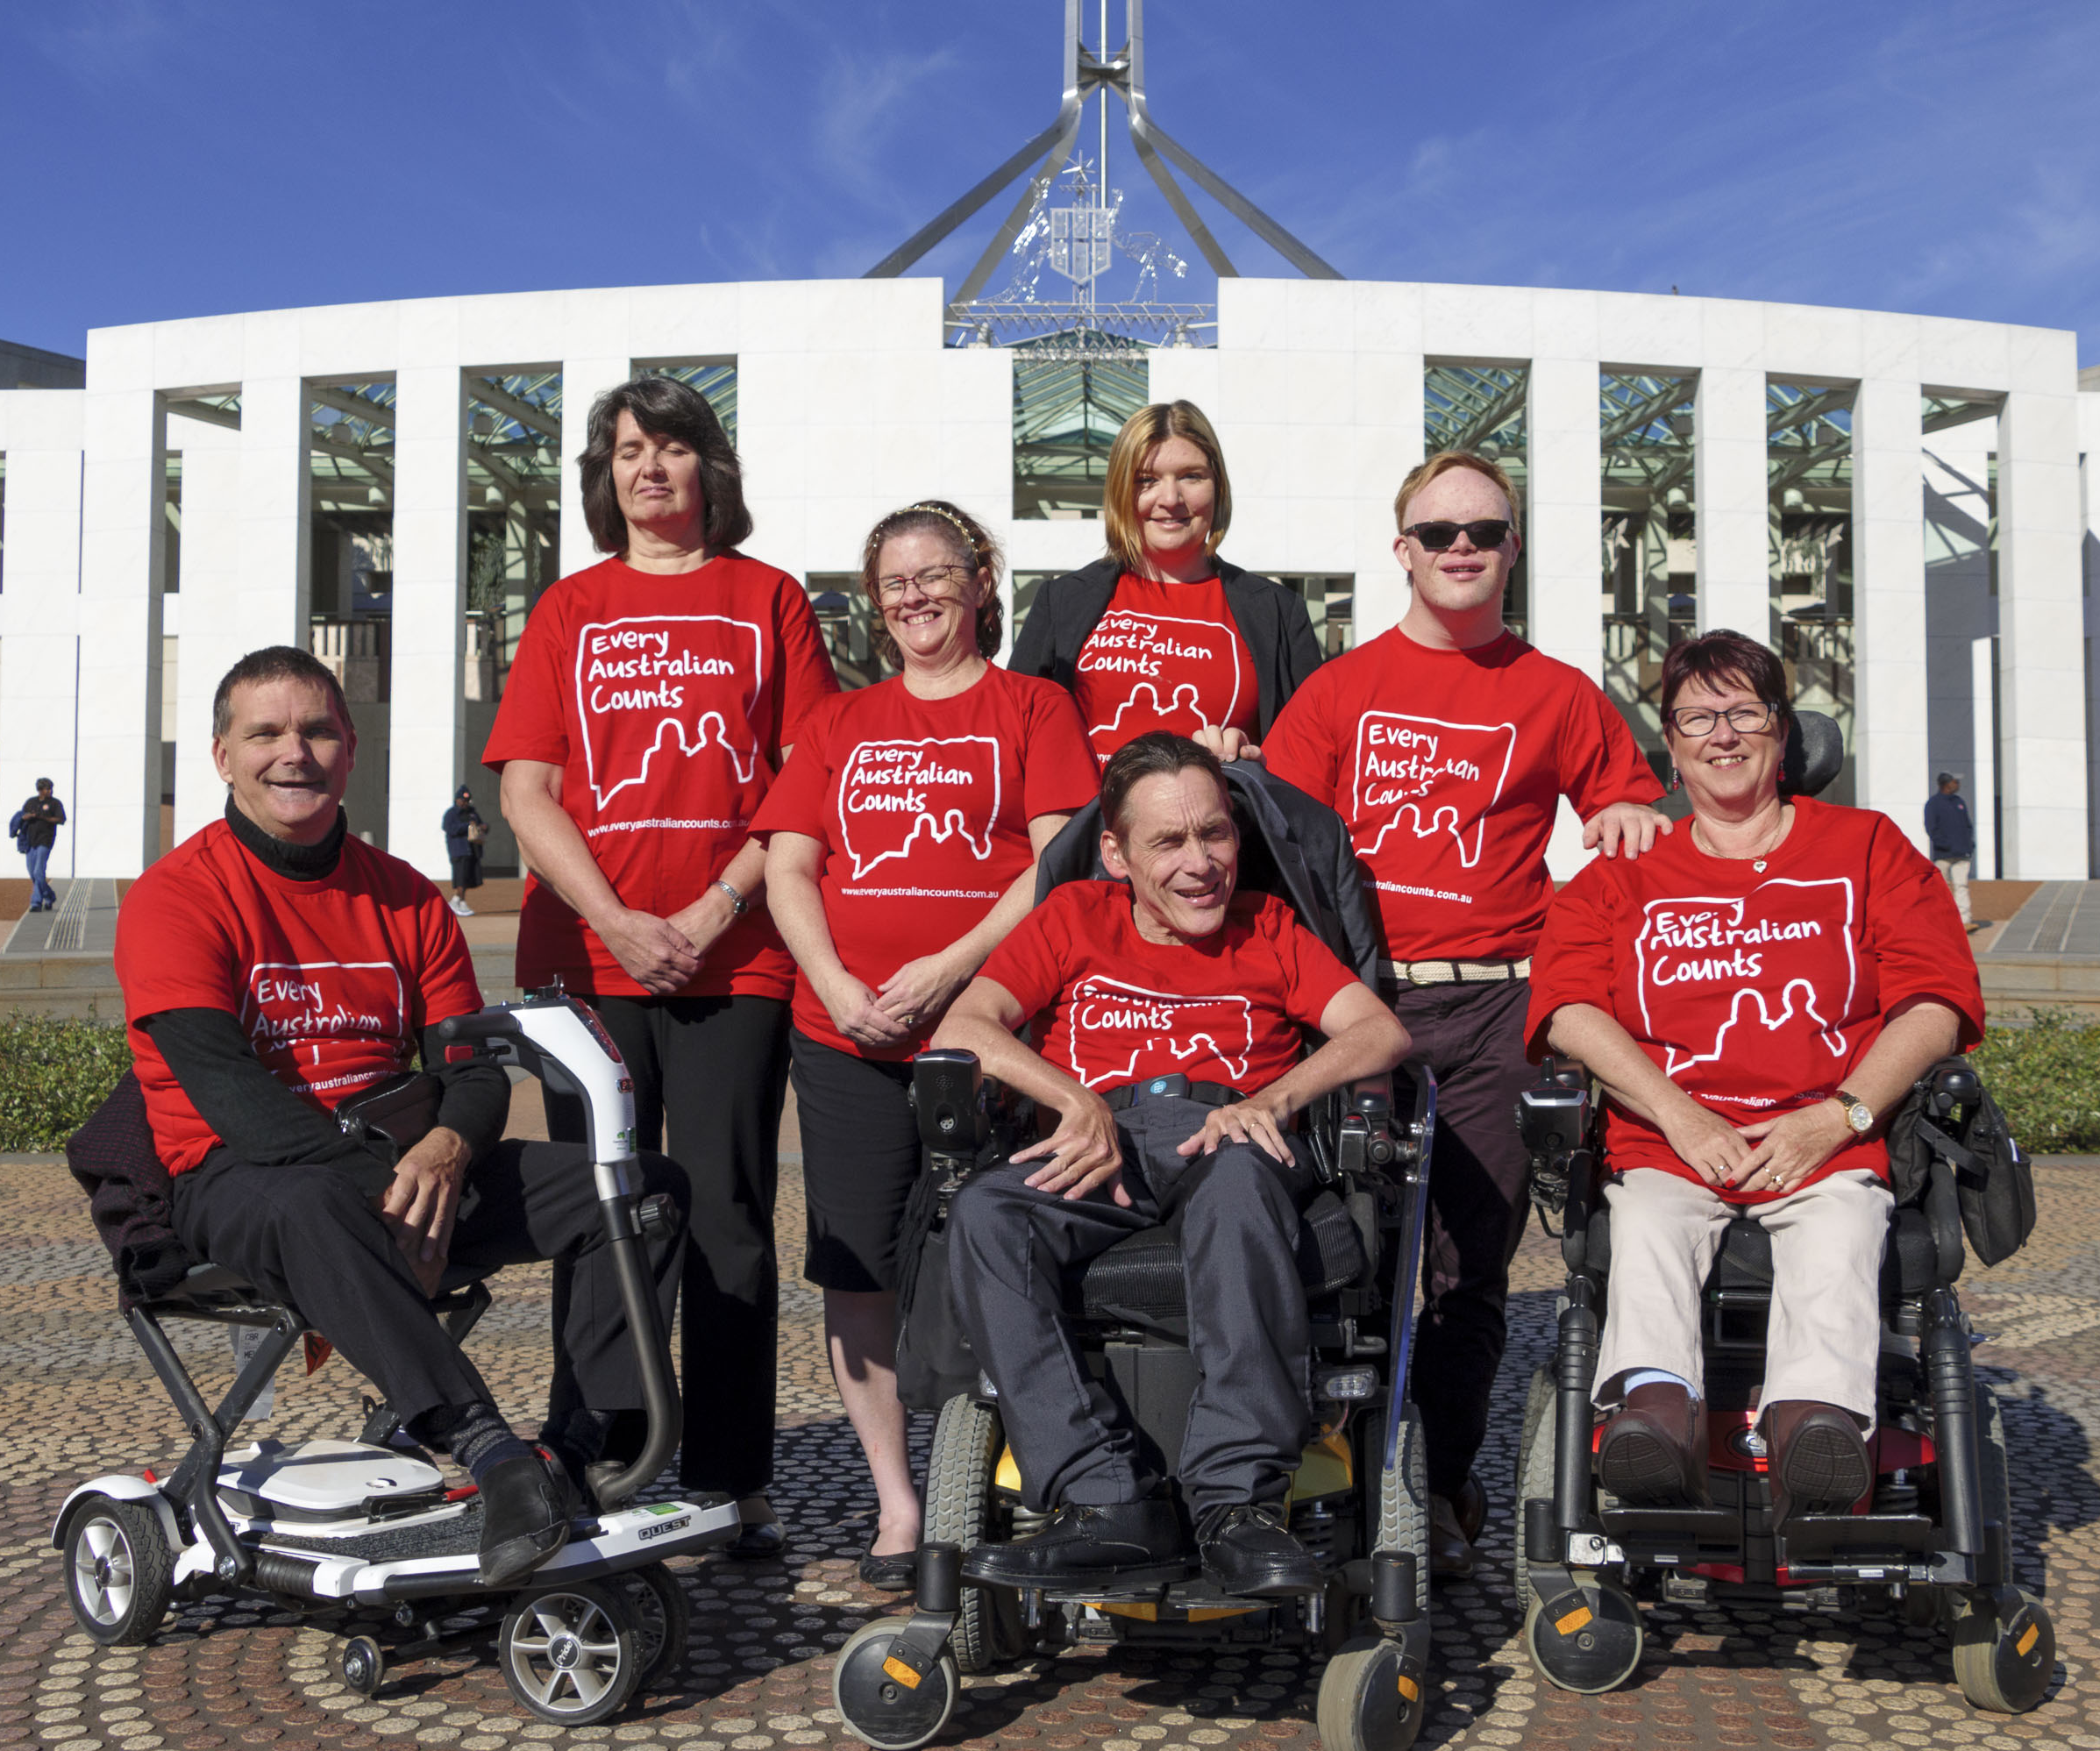
Nothing about us, without us!
STOP the rollout of compulsory assessments as they are currently planned
Co-design a new access and planning process with people with disability, their families, supporters and the organisations who represent them.
Notes:
The fundamental issue
The immediate outcry occurred because the government broke its fundamental promise to people with disability to engage as equal partners in decisions that will affect their lives. The mantra ‘Nothing about us, without us’ is not a negotiable or a privilege. The NDIS Act - the law - acknowledges this as a right.
Therefore, the first and primary request to government is to STOP the rollout of compulsory assessments as they are currently planned, and to co-design a new access and planning process with people with disability, their families, supporters and the organisations who represent them.

Slide 8
Will the information be ‘accurate’?
Many experts and academics say the tools are not designed to determine the level of support funding needed by an individual
We have not been told how the level of funding in a package might change
The results of the assessment cannot be challenged or appealed
People might miss out on the NDIS, or not have their support needs met
A strong transparent and independent evaluation is needed
Notes:
What if the information is not ‘accurate’?
The announcement about independent assessments said they would be the central source of ‘accurate’ information about a person with disability’s support needs. But we do not have any evidence that they are accurate.
In fact, many experts and academics have said that the tools used in the assessments were not designed to determine the level of support funding needed by an individual.
The government has not told us how assessment results will be used to work out a person’s budget. We have not been told how the level of funding in a package might change.
The government has also said the results of the assessment cannot be challenged or appealed. Even though it hasn’t proved that the results will be accurate.
We don’t think that is a good way to make big changes. In fact, we think it is dangerous to make major changes to the lives of nearly half a million Australians, about 60% of whom have a cognitive disability, without rigorously testing the impact using the best evidence available.
We think it is unfair that people might miss out on the NDIS, or not have their support needs met.
We think there needs to be a strong transparent and independent evaluation of proposed tools and methods to show they are accurate.

Slide 9
Change is OK
The NDIS is world leading, it does need to try new things
The NDIS is complex and difficult to navigate. There are problems with fairness and consistency. While the scheme works well for some, others miss out.
We want the NDIS to be fair and consistent. Of course.
But we are concerned these changes will make things worse not better
Notes:
There are some challenges. Change is OK.
I want to be clear that our worries don’t mean we are against change. Because the NDIS is world leading, it does need to try new things.
And it is true that, right now, the NDIS is complex and difficult to navigate. There are problems with fairness and consistency. While the scheme works well for some, others miss out.
We want the NDIS to be fair and consistent. Of course. But we are concerned these changes will make things worse not better. We are concerned that the new process for assessment and planning won’t consider the individual needs and circumstances of people with disability.

Slide 10
The obvious solution
Codesign, codesign, codesign
Evaluate, evaluate, evaluate
Notes:
The obvious solution
There is an obvious solution.
The Australian Government and people with disability, families and service providers could look at the problems and come up with solutions that we think will work together. Just like we did to make the NDIS happen.
These solutions could include trials of a range of ways to improve access and planning consistency, and should be evaluated so that evidence based changes are made.

Slide 11
We want the NDIS we fought for
Notes:
We want to help
We want to make sure the NDIS is the world-leading scheme we believe it can and should be. After all it’s our NDIS. It belongs to our community.
The NDIS is a new system. It was deliberately designed to be different to the old systems, which left people with disability ‘Shut Out’. A critical difference is the NDIS is individualised and personalised. Every NDIS participant should get a plan that supports their unique needs and circumstances.
We do not want the NDIS we fought for to be turned into Workcover or Centrelink.
We want the NDIS we fought for.

